Slide 1

DEPARTMENT OF Electrical & Electronics Engineering
Industrial oriented mini project
on
SOLAR POWERED CLEANING ROBOT
BATCH NO : 04
PROJECT ASSOCIATES :
N. ANILA - 22275A0217
MD AMEER KHAN - 22275A0210
B.MADHU - 22275A0214
SD.FEROZ - 22275A0212
PROJECT GUIDE
Mr. CH. SAJAN RAO M.Tech. (Ph.D.)
Associate Professor
Department of EEE

Slide 2
PROJECT OUTLINE
Introduction
Objective
Proposed model
Components used
Circuit diagram
Working principle
Application
Advantages
Result
Conclusion
Future scope

Slide 3
INTRODUCTION
The solar-powered Panel cleaning robot project aims to develop an autonomous cleaning device that utilizes solar energy to enhance efficiency and sustainability in maintaining floor, solar panel cleanliness.
The primary purpose of this robot is to minimize human intervention in routine floor, solar panel cleaning tasks while promoting environmentally friendly practices through the use of renewable energy sources.
The robot is equipped with a dual cleaning mechanism, combining both sweeping and mopping functions to tackle different types of debris and stains.
The integration of solar panels into the robot's design ensures that it can recharge autonomously, making it capable of extended cleaning sessions without the need for frequent human intervention.
Overall, this project represents a significant step towards creating intelligent, eco-friendly solutions for everyday cleaning tasks.

Slide 4
OBJECTIVE
To design a solar panel cleaning robot.
To design a solar panel cleaning system that can increase the efficiency of solar panels.
To increase the use of solar panels.
To clean solar panels simply by using automation.
Integrate smart features like scheduling, remote control via apps, and AI for adaptive cleaning based on floor condition.
To minimize hazards to humans.

Slide 5
PROPOSED MODEL
The robot is powered by a solar panel system, ensuring clean and renewable energy for its operation.
A rechargeable battery stores energy to allow continuous operation during low sunlight conditions or at night.
Facilitates IoT functionality for remote monitoring and control using Wi-Fi connectivity.
The cleaning system can be activated and controlled using a 2-channel relay module connected to the microcontroller.
The Node MCU ESP8266 enables remote operation and monitoring through a mobile application or web interface.

Slide 6
components USED
Node MCU
L298N Motor Driver Module
DC Geared Motors
Soldering Kit
Switch
Solar Panel
Lithium-Ion Batteries
Jumper Wires

Slide 7
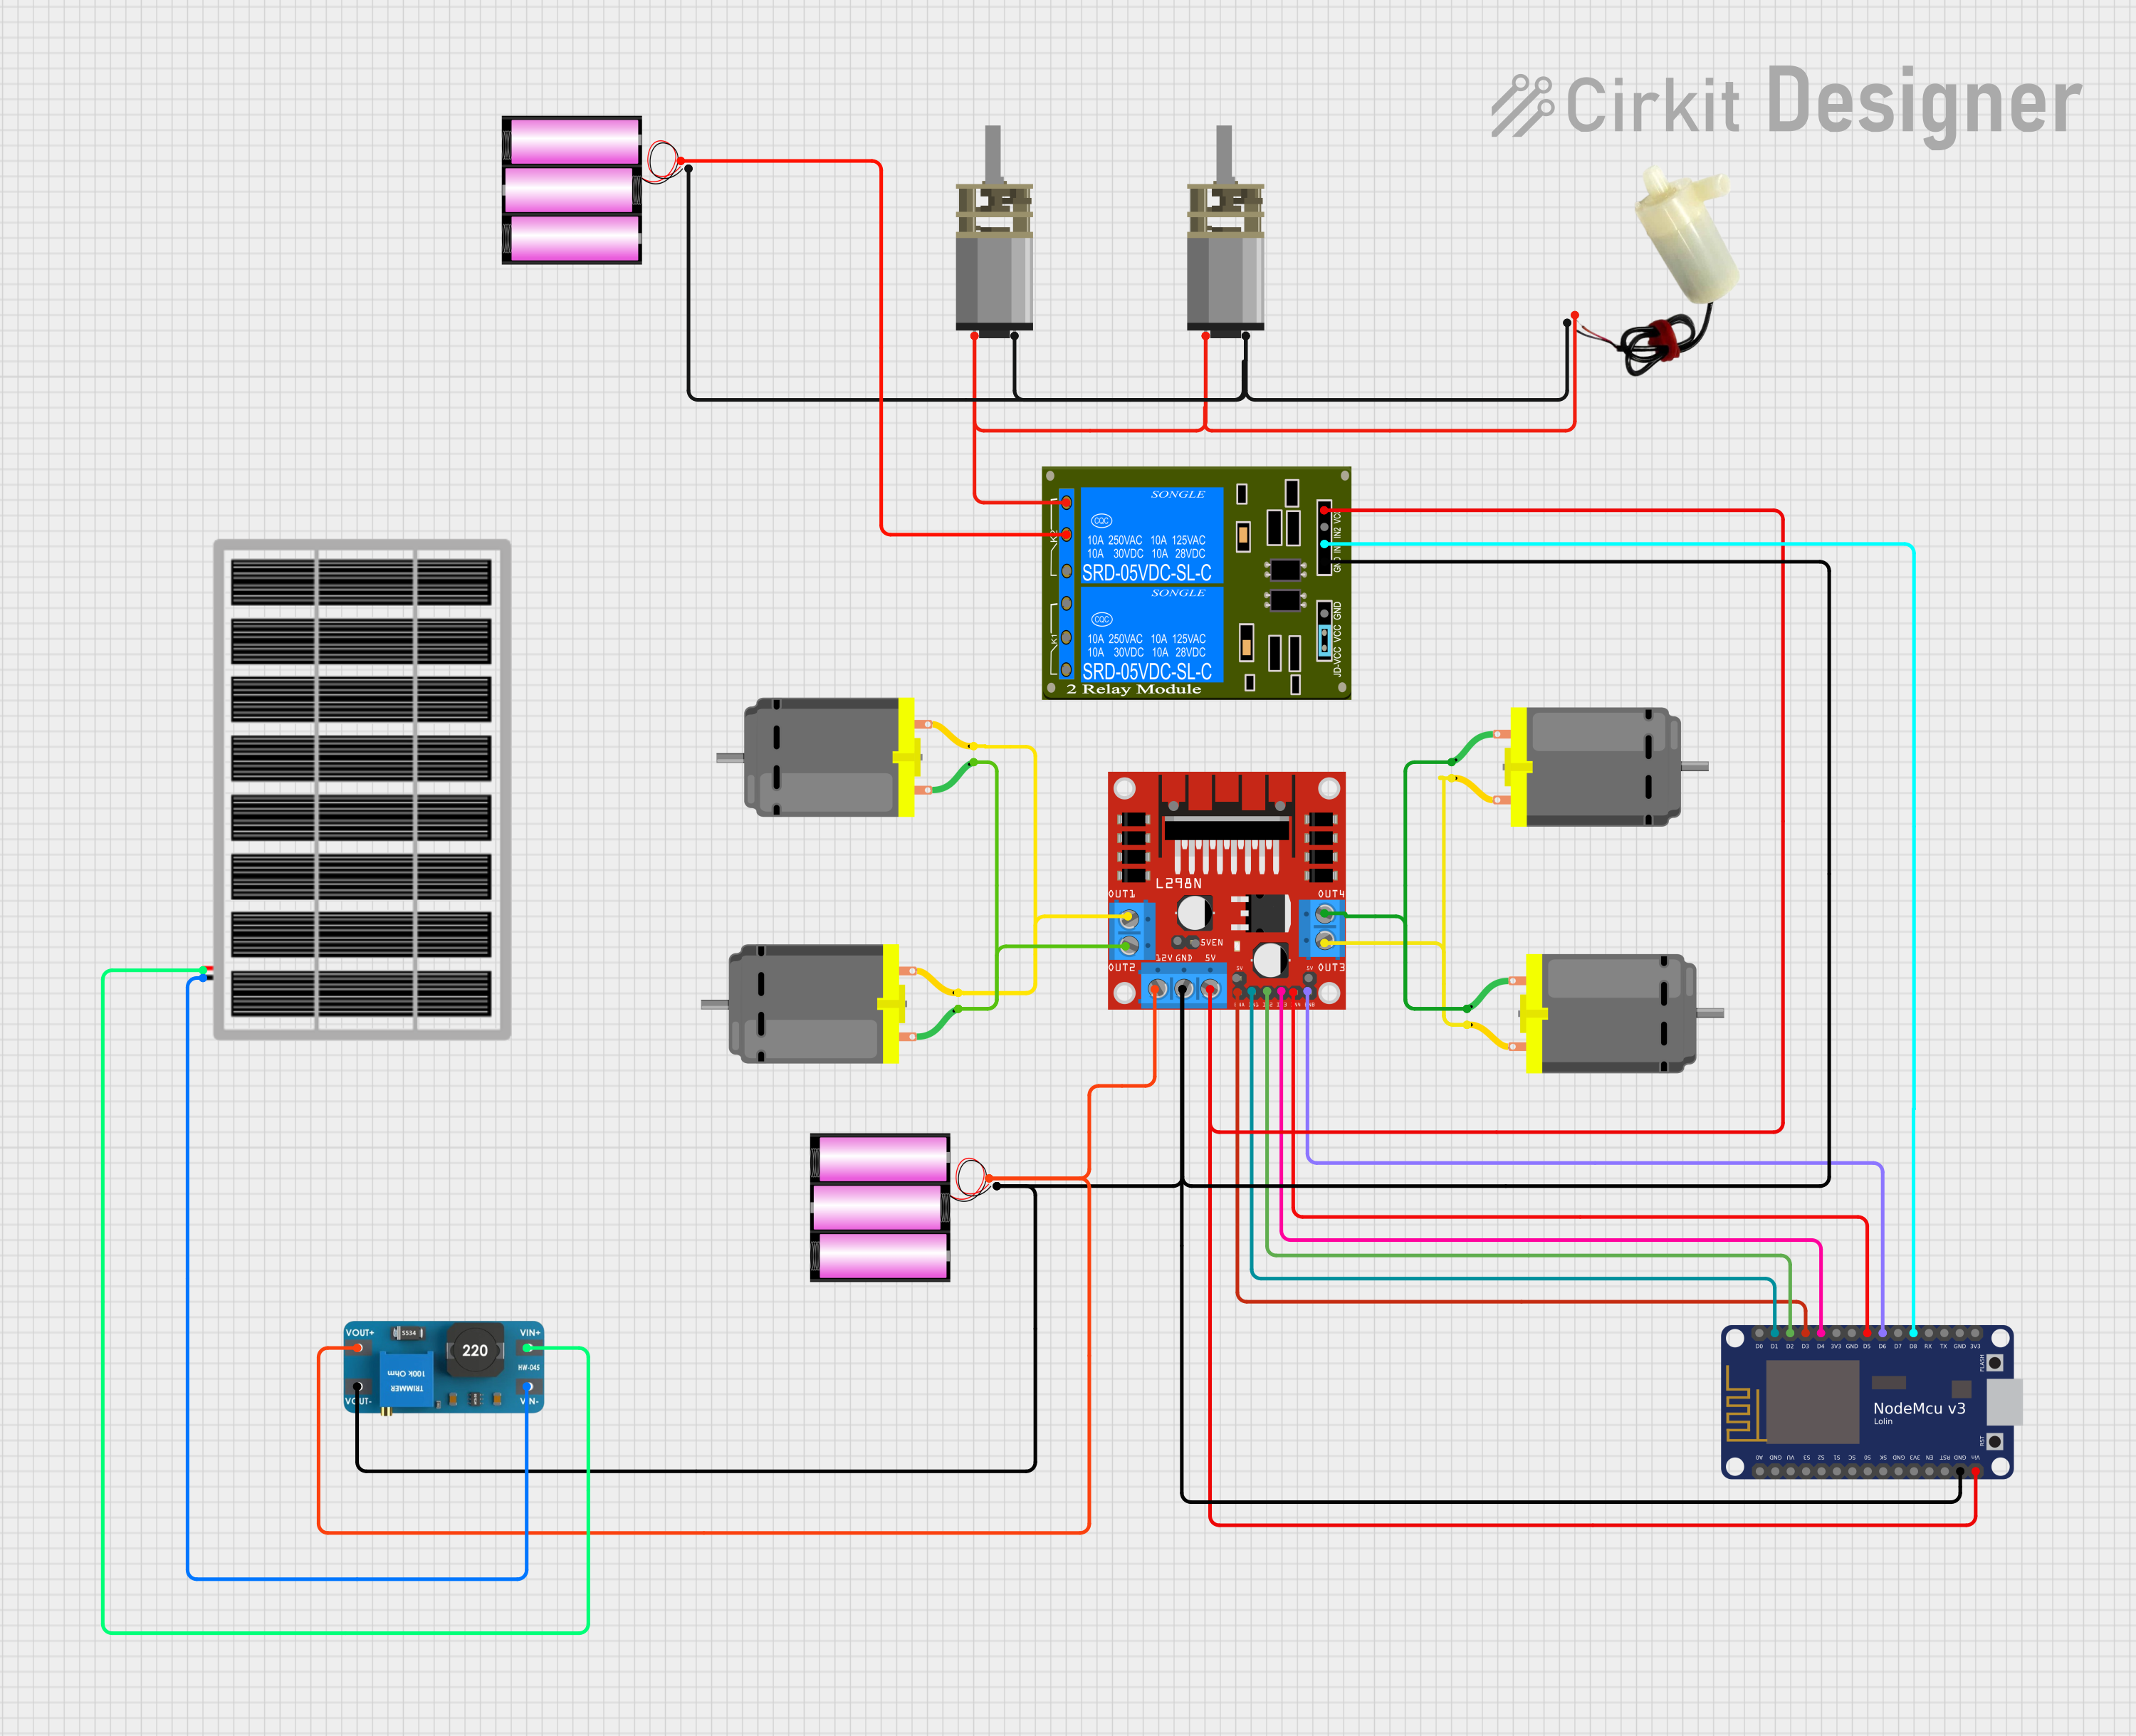
CIRCUIT DIAGRAM

Slide 8
Node MCU
Node MCU is an open-source IoT platform based on the ESP8266 microcontroller, designed for easy integration with Wi-Fi and IoT applications.
Easy to use and widely supported by an active developer community.
Low cost and energy efficient.
Built-in Wi-Fi capability.
Multiple GPIO pins for interfacing sensors and modules.

Slide 9
L298N Motor Driver Module
This L298N Motor Driver Module is a high power motor driver module for driving DC and Stepper Motors.
Operates with a wide voltage range (4.5V to 36V).
Efficient motor control for bidirectional motion.
Simple interface with microcontrollers.
Capable of handling up to 2A of current per motor.

Slide 10
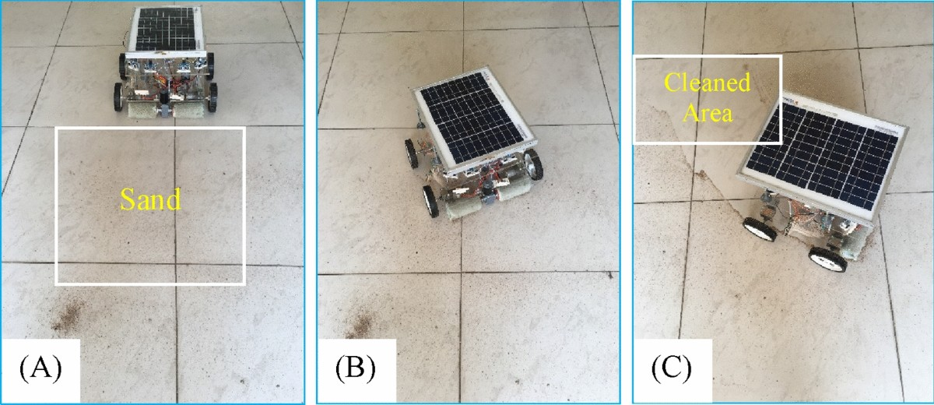
WORKING PRINCIPLE
The working principle of a solar-powered floor-cleaning robot revolves around harnessing solar energy for autonomous cleaning operation.
The robot is equipped with solar panels that capture sunlight and convert it into electrical energy, which is stored in rechargeable batteries.
The cleaning mechanism, which may include brushes, suction units, or mopping systems, removes dirt and debris from the floor surface.

Slide 11
APPLICATION
Efficiently cleans solar panels, enhancing their performance by removing dirt and debris, especially in remote or off-grid locations where traditional power sources are limited.
Autonomous cleaning of floors in homes, using solar energy to reduce reliance on conventional electricity, while ensuring sustainable cleaning practices.
Deal for environmentally conscious consumers and organizations looking for sustainable and energy-efficient alternatives to traditional cleaning method
Used in offices, warehouses, and large commercial spaces to reduce human labor and energy consumption, while maintaining cleanliness

Slide 12
ADVANTAGES
Efficient low cost design.
It minimizes environmental impact compared to traditional energy-powered robots.
Solar-powered robots can be designed for a variety of cleaning tasks, including dust removal, scrubbing, or vacuuming.
Encourages innovation in renewable energy and robotics integration.
In cases of power outages, solar-powered robots can continue to function as long as sunlight is available, ensuring uninterrupted cleaning operations..

Slide 13
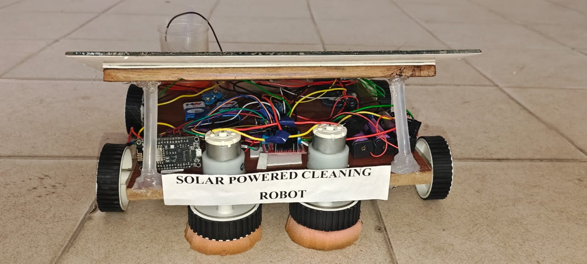
RESULTS

Slide 14
CONCLUSION
Solar-powered cleaning robots represent a significant step forward in the pursuit of sustainable and efficient automation technologies.
By leveraging renewable energy, these robots reduce reliance on conventional power sources, minimize energy costs, and contribute to environmental sustainability.
They have demonstrated their utility in various sectors, including residential, commercial, and industrial applications, offering precision and reliability with minimal human intervention.

Slide 15
FUTURE SCOPE
The future of solar-powered cleaning robots is expensive, with significant potential for innovation and integration into various industries.
Integration with artificial intelligence and IoT (Internet of Things) could enable these robots to work autonomously with real-time adaptability, improving their efficiency in diverse applications such as residential cleaning, large-scale industrial maintenance, and solar farm upkeep.
These advancements will position solar-powered cleaning robots as key players in sustainable automation solutions for a wide range of industries.

Slide 16


